Slide 1

FIND SUITABLE LOCATIONS FOR OPENING RESTAURANT IN TORONTO
The Battle of Neighborhood
Le Thanh Lam

Slide 2

Content
Introduction
Data
Methodology
Result
Discuss & Conclusion

Slide 3
Introduction
Toronto, city, capital of the province of Ontario, southeastern Canada. It is the most populous city in Canada, a multicultural city… it enabled Toronto to become an important international trading centre
Company XYZ JSC would like finding the most suitable locations for opening new restaurants in Torronto

Slide 4

DATA
Data set of locations in Toronto https://en.wikipedia.org/wiki/List_of_postal_codes_of_Canada:_M
Data set of geographical coordinates of the neighborhoods in Toronto in Toronto: https://cocl.us/Geospatial_data
Data set of pupolation of the locations in Toronto : https://en.m.wikipedia.org/wiki/Demographics_of_Toronto#Ethnic_diversity
Data set of restaurant of API FourSquare by each location
Other dataset: on internet…
Location
Number of restaurant
pupolation

Slide 5
METHODOLOGY
Prepares data about location and pupolcation from data wikipedia
From on Foursquare API to get all restaurant of each neighborhoods, then group by each neighborhoods and to count how many restaurant of each neighborhoods
Create dataset that consists : number of restaurant and total of population for each location
Filter top 5 most common venue types of each neighborhoods by : visualization and query data

Slide 6
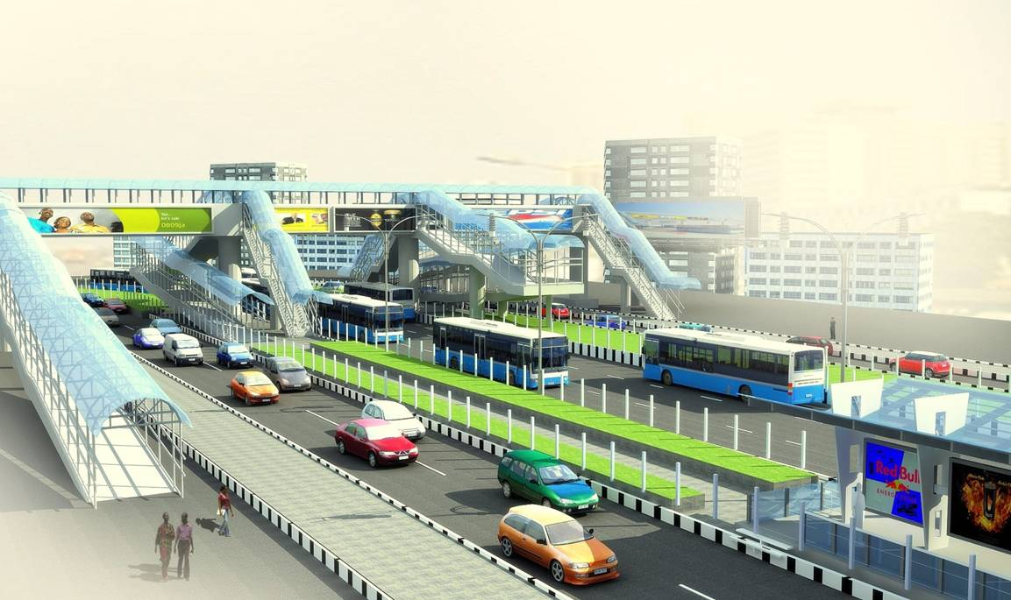
RESULT

Slide 7
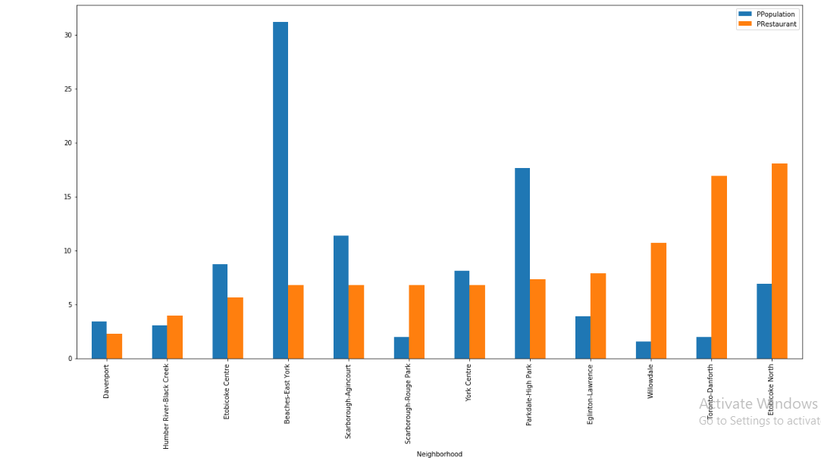
Data visualization on bar graph

Slide 8
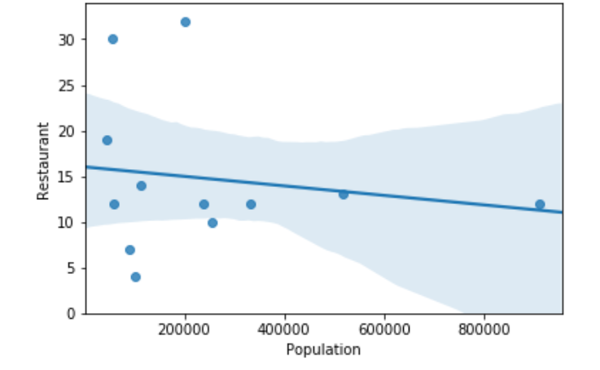
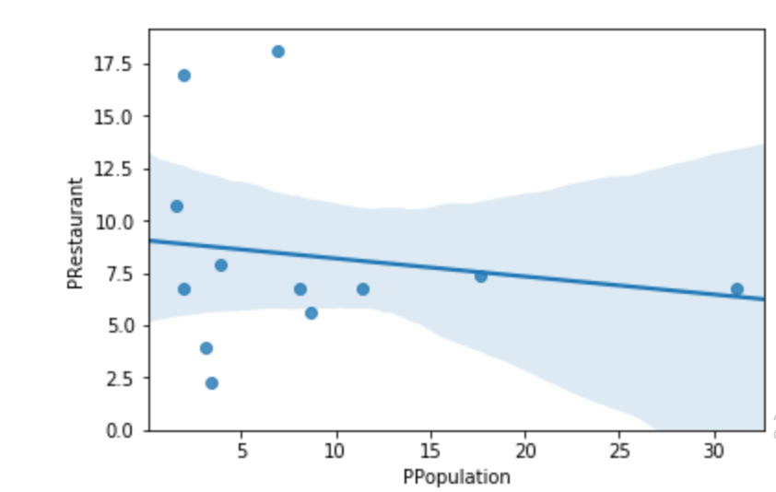
Correlations of restaurants and population each location

Slide 9
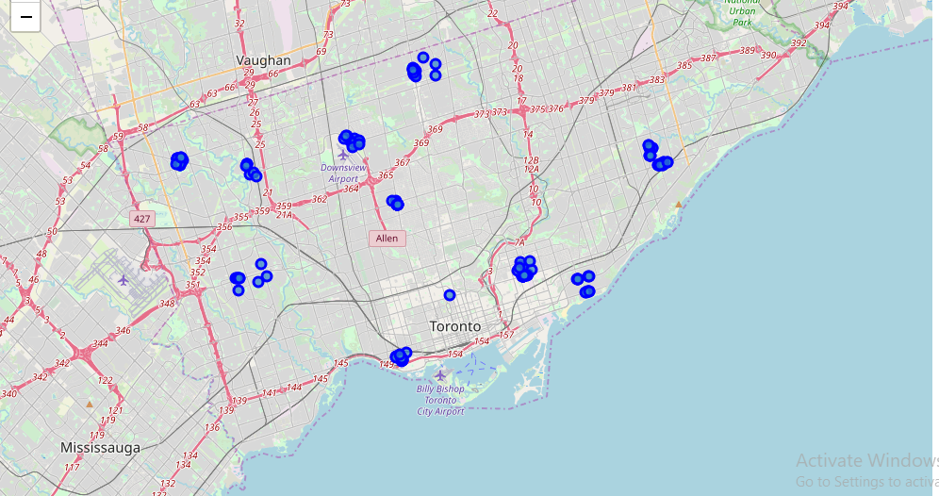
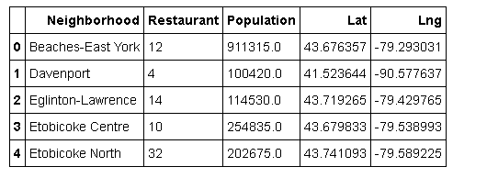
Restaurants on the maps (distribution is not same in Toronto)

Slide 10
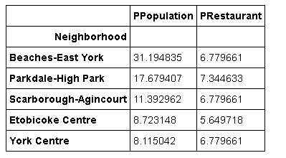
TOP LOCATIONS FILTER BY QUERY DATA
Origin data source
Data of top 5 locations
(fit with visuallization)

Slide 11
Results
Restaurants is distributed not same in locations in Toronto
Beaches. -East York takes most populations (31.19%) but there is few restaurants (6.7%)
Etobikco Noth takes few populations but there is a lot of restaurants
Top 5 locations is suitable for open new restaurants is

Slide 12
DISCUSSION AND CONCLUSION

Slide 13
Discussion & Conclusion
Through visual analysis and data analysis, we have analyzed the best location to invest in XYZ JSC based on the graph of two characteristics: population and number of restaurants in each location, and we have found the best 5 places for open new restaurnts
We can gather more specific features besides: location, population, number of restaurants like: income, area, population age,… in detail for each location to process more accurately
Use the method in this project we can find even more accurate and detail result , the restaurant type is more suitable for each ethnic if we have enough of data

